Slide 1
Hierarchical Scheduler
For Deep Learning Cluster
HKU Summer Research Presentation
Juyi Lin
Supervised by Prof. C.Wu
2021/08/30
Notes:
Good afternoon, professor! I am glad to present my summer research project here. The topic of my project is hierarchical reinforcement learning for allocating GPU resources and place jobs.

Slide 2
Outline
01
02
03
Background
Progress
Future Work

Slide 3


01
Background
Shared compute cluster
Deep Learning Training
in shared Clusters
Submit ML jobs
Submit # GPUs
Expensive hardware (e.g., GPUs)

Slide 4
01
Background
PS
worker
Parameters Server Architecture
GPU0
GPU3
dataset
gradient
parameters
worker
worker
GPU1
GPU2
dataset
dataset

Slide 5
01
Background
Add more worker?
Non-linear!
more communication overhead
How much faster can model train after adding extra resources?
PS: worker = 1:3 is best?

Slide 6
01
Background
Cluster Scheduler
Submit ML jobs
Cluster scheduler decides how to allocate resources to jobs in order to minimize training time and maximize cluster utilization

Slide 7
01
Background
Colocated jobs
The workers and Parameter servers on different physical servers
Co-located ML jobs interfere with each other negatively
Notes:
the

Slide 8
01
Background
Colocated jobs
Notes:
the

Slide 9
01
Background
Node0
Colocated jobs
GPU1
GPU2
job1
PCIe sharing
job2
PCIe
PCIe switch
NVLink
CPU1
Notes:
For example, when the GPU cards on a server are allocated to different ML jobs, the PCIe bus is shared when the jobs shuffle data between their allocated CPU and GPU.

Slide 10
01
Background
Node0
Node1
Colocated jobs
GPU1
GPU2
GPU3
GPU4
QPI sharing
PCIe
PCIe switch
PCIe switch
NVLink
QPI
CPU1
CPU2
Notes:
the QPI bus is shared when two allocated GPUs are not attached to the same CPU in the non-uniform memory access architecture.

Slide 11
01
Background
 | Key idea | Parallel type
Spotlight: Optimizing Device Placement for Training Deep Neural Networks 2018 | reinforcement learning algorithm based on proximal policy optimization | Parameters parallel operation placement
A HIERARCHICAL MODEL FOR DEVICE PLACEMENT 2018 | assign graph operations to groups and to allocate those groups to devices | Parameters parallel , operation placement
Tiresias: A GPU Cluster Manager for Distributed Deep Learning nsdi 2019 | 2D Attained Service-Based Scheduler scheduling framework | Data parallel, worker placement

Slide 12
01
Background
Explicit model
Couple with ML framework implementation
without considering interference
End to end

Slide 13
02
Progress
Read previous work and find potential limitations
Design the hierarchical method
Calculate the communication time in PS and Allreduce architecture.
Extract data from the trace for fitting the training speed function
Finished srtf,fifo,drf etc. baseline.

Slide 14
02
Progress
Job owner
api
State s
State s
Job type
Job type
Allocate worker/PS
Resource demand
Run time
placement
Policy NN
Worker/PS
Policy NN
Remaing epoch
available resource
Domain resource
Current placement
Job’s worker/PS
api

Slide 15


02
Progress
PS communication time
$$time = \frac{throughput}{bandwidth}=\frac{2∗size(θ)∗(N)}{B}$$
$$throughput= 2 ∗ 4bytes ∗ gradientNum∗ workerNum$$
N = workerNum
B = bandwidth
$$gradientNum = parameterNum$$

Slide 16
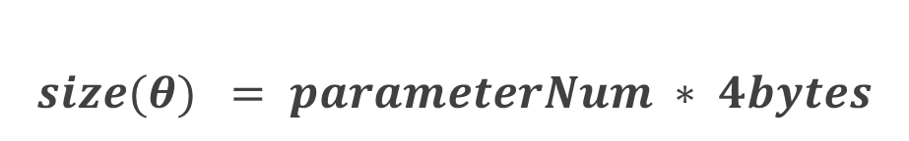
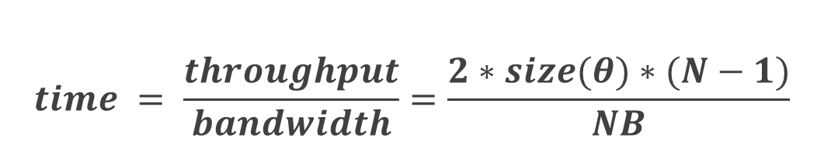
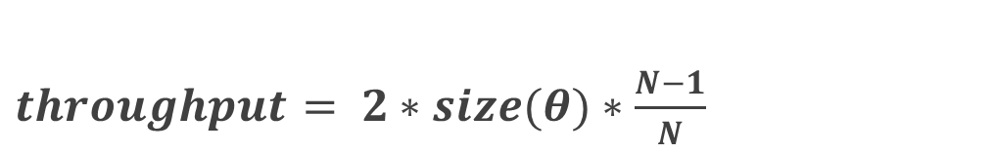
02
Progress
Allreduce communication time
$$time = \frac{throughput}{bandwidth}=\frac{2∗size(θ)∗(N−1)}{NB}$$
$throughput$ $= 2∗size(θ)∗\frac{N−1}{N}$
N = workerNum
$$size(θ) = parameterNum ∗ 4bytes$$
B = bandwidth

Slide 17
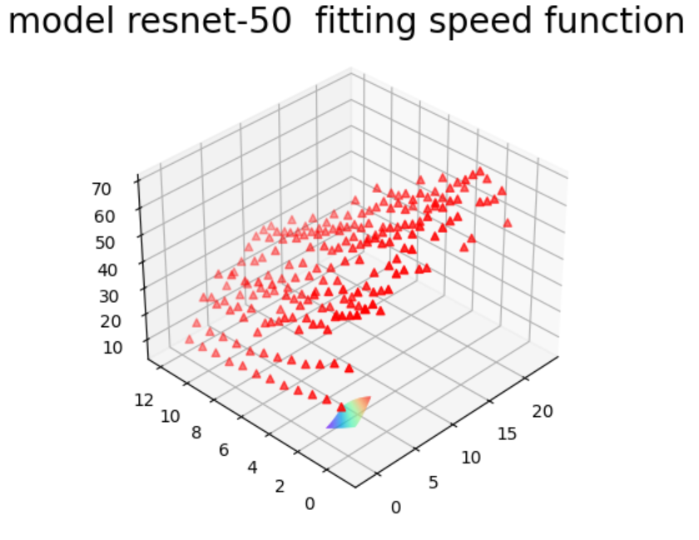
02
Progress
fitting the training speed function

Slide 18
03
Future work
Implement reinforcement learning and evaluate it in the experiment
implement some optimization in reinforcement learning like experience replay, job-aware exploration.

Slide 19
Reference
1. Peng, Y. et al. DL2: A Deep Learning-driven Scheduler for Deep Learning Clusters. arXiv:1909.06040 [cs, stat] (2019).
2. Bao, Y., Peng, Y. & Wu, C. Deep Learning-based Job Placement in Distributed Machine Learning Clusters. in IEEE INFOCOM 2019 - IEEE Conference on Computer Communications 505–513 (IEEE, 2019). doi:10.1109/INFOCOM.2019.8737460.
3. Qiao, A. et al. Pollux: Co-adaptive Cluster Scheduling for Goodput-Optimized Deep Learning. arXiv:2008.12260 [cs] (2021).
4. Gao, Y., Chen, L. & Li, B. Spotlight: Optimizing Device Placement for Training Deep Neural Networks. 9.
5. Mirhoseini, A. et al. A HIERARCHICAL MODEL FOR DEVICE PLACEMENT. 11 (2018).
6. Gu, J. et al. Tiresias: A GPU Cluster Manager for Distributed Deep Learning. 17 (2019).

Slide 20
Thank you for listening!
HKU Summer Research Presentation
Juyi Lin
2021/08/30
Notes:
That’s all, thank you for listening!

